Slide 1


GitHub
Lecture # 03
HITEC University, Taxila
Mr. Mubashir Iqbal
Fall-2025

Slide 2
Content
What is a Git Branch?
What is a GitHub Branch?
GitHub Branch Merge
GitHub Forking
GitHub Badges
GitHub Organization

Slide 3
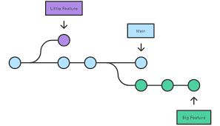
What is a Git Branch?
In Git, a branch is like a separate workspace where you can make changes and try new ideas without affecting the main project. Think of it as a “parallel universe” for your code.
Why Use Branches?
Branches let you work on different parts of a project, like new features or bug fixes, without interfering with the main branch.
Common Reasons to Create a Branch
Developing a new feature
Fixing a bug
Experimenting with ideas

Slide 4
Example Without Git
How would that work without Git:
Make copies of all the relevant files to avoid impacting the live version
Start working with the design and find that code depend on code in other files, that also need to be changed!
Make copies of the dependant files as well. Making sure that every file dependency references the correct file name
EMERGENCY! There is an unrelated error somewhere else in the project that needs to be fixed ASAP!
Save all your files, making a note of the names of the copies you were working on
Work on the unrelated error and update the code to fix it
Go back to the design, and finish the work there
Copy the code or rename the files, so the updated design is on the live version
(2 weeks later, you realize that the unrelated error was not fixed in the new design version because you copied the files before the fix)

Slide 5
Example With Git
How would that work with Git:
With a new branch called new-design, edit the code directly without impacting the main branch
EMERGENCY! There is an unrelated error somewhere else in the project that needs to be fixed ASAP!
Create a new branch from the main project called small-error-fix
Fix the unrelated error and merge the small-error-fix branch with the main branch
You go back to the new-design branch, and finish the work there
Merge the new-design branch with main (getting alerted to the small error fix that you were missing)

Slide 6
Importance of Branches
Branches allow you to work on different parts of a project without impacting the main branch.
When the work is complete, a branch can be merged with the main project.
You can even switch between branches and work on different Projects/Features without them interfering with each other.
Branching in Git is very lightweight and fast!

Slide 7
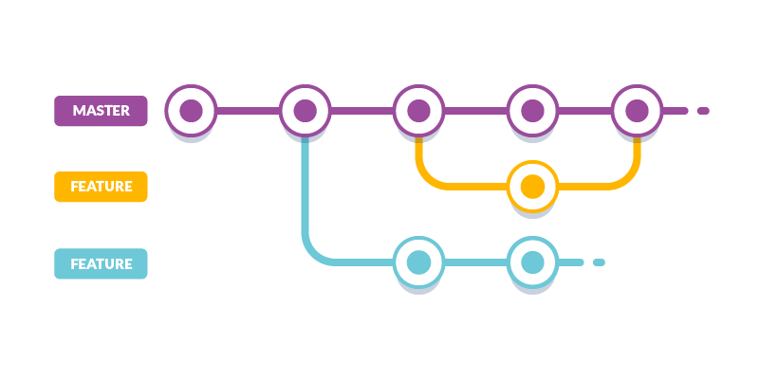
Example With Git

Slide 8
Creating a New Branch
Let’s say you want to add a new feature. You can create a new branch for it.
Let add some new features to our index.html page.
We are working in our local repository, and we do not want to disturb or possibly wreck the main project.
So, we create a new branch:
Example
git branch hello-world-images
We just created a new branch called “hello-world-images”

Slide 9
Listing All Branches
Let's confirm that we have created a new branch.
To see all branches in your repository, use:
Example
git branch
hello-world-images
* master
We can see the new branch with the name “hello-world-images”, but the * beside master specifies that we are currently on that branch.

Slide 10
Switching Between Branches
Checkout is the command used to check out a branch.
Moving us from the current branch, to the one specified at the end of the command:
git checkout hello-world-images
Switched to branch “hello-world-images”
Now you can work in your new branch without affecting the main branch.

Slide 11
Deleting a Branch
When you’re done with a branch, you can delete it:
git branch -d hello-world-images
This deletes the branch named hello-world-images (if it’s already merged).

Slide 12
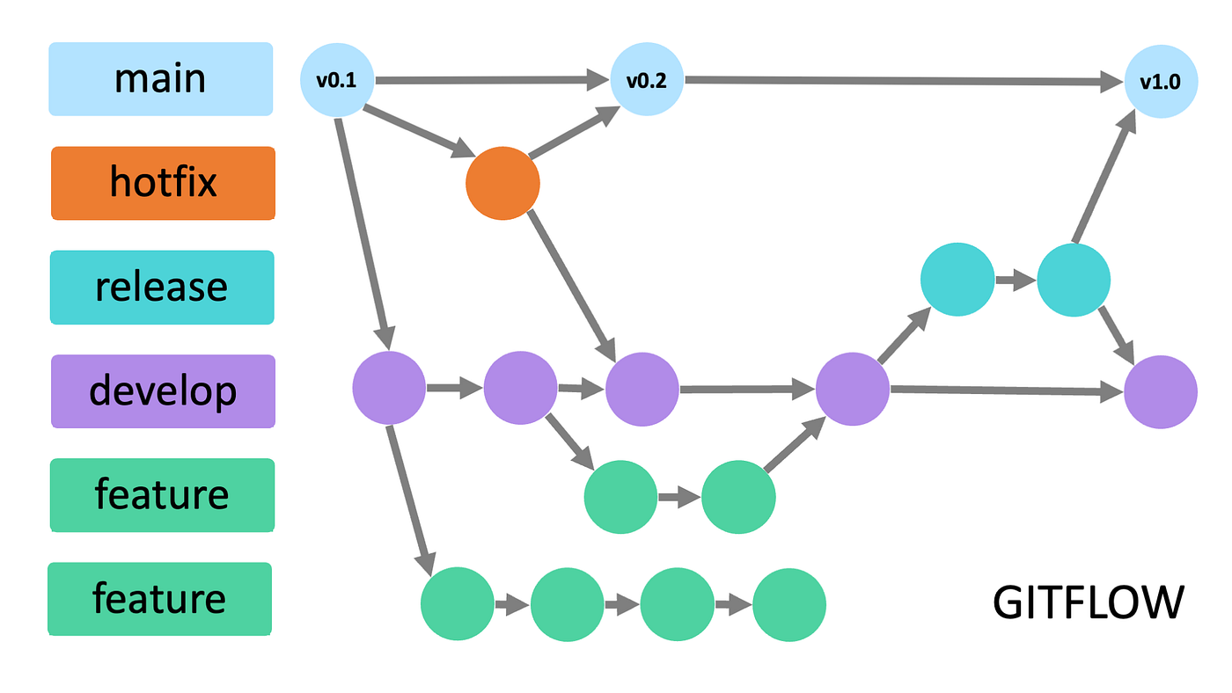
Example With Git

Slide 13
GitHub Branch

Slide 14
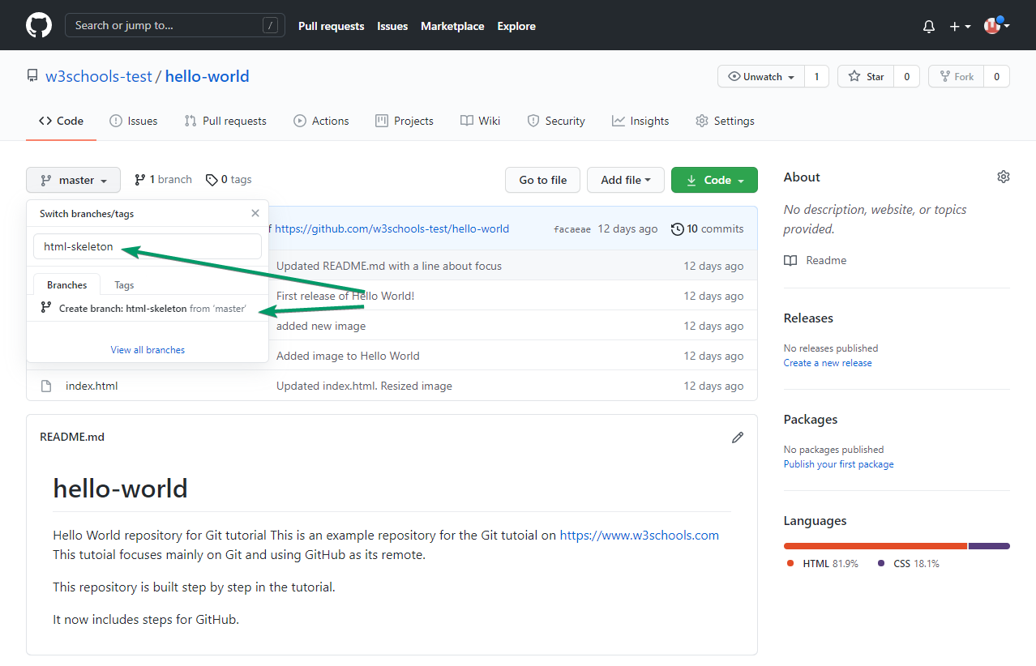
GitHub Branch
On GitHub, access your repository and click the "master" branch button.
There you can create a new Branch. Type in a descriptive name, and click Create branch:

Slide 15
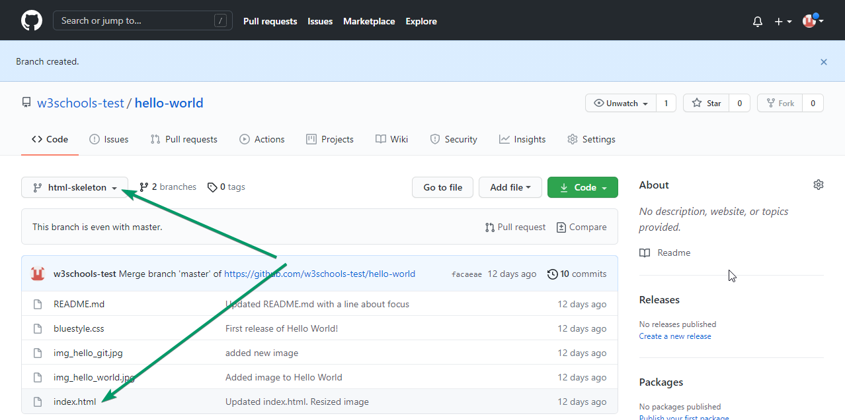
GitHub Branch
The branch should now be created and active. You can confirm which branch you are working on by looking at the branch button. See that it now says "html-skeleton" instead of "main"?

Slide 16
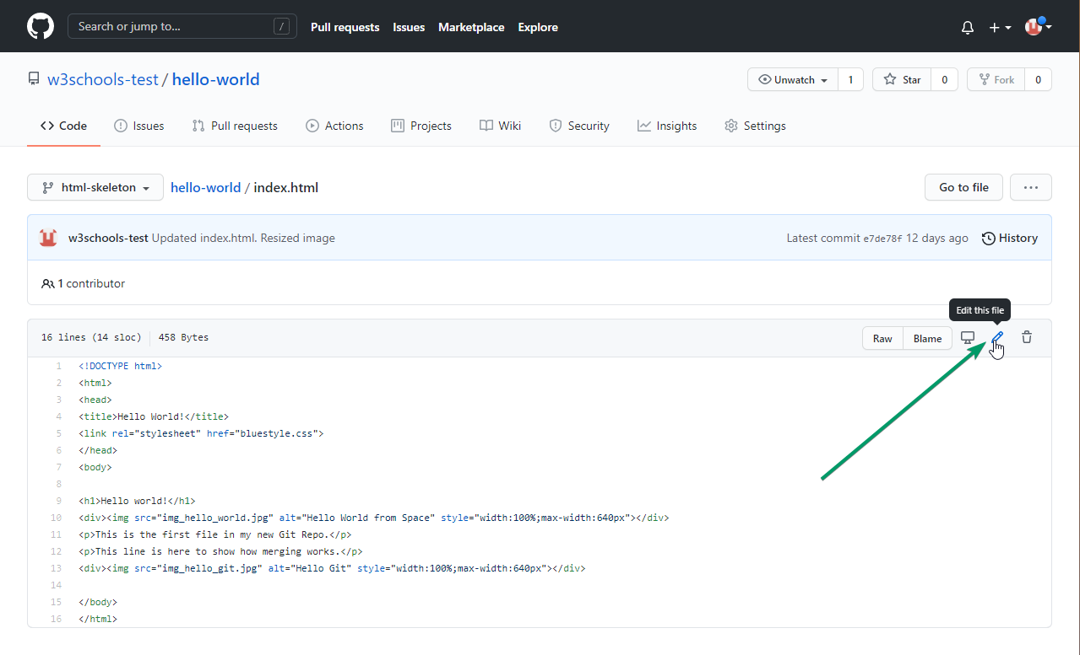
Git GitHub Branch
Start working on an existing file in this branch. Click the "index.html" file and start editing:

Slide 17
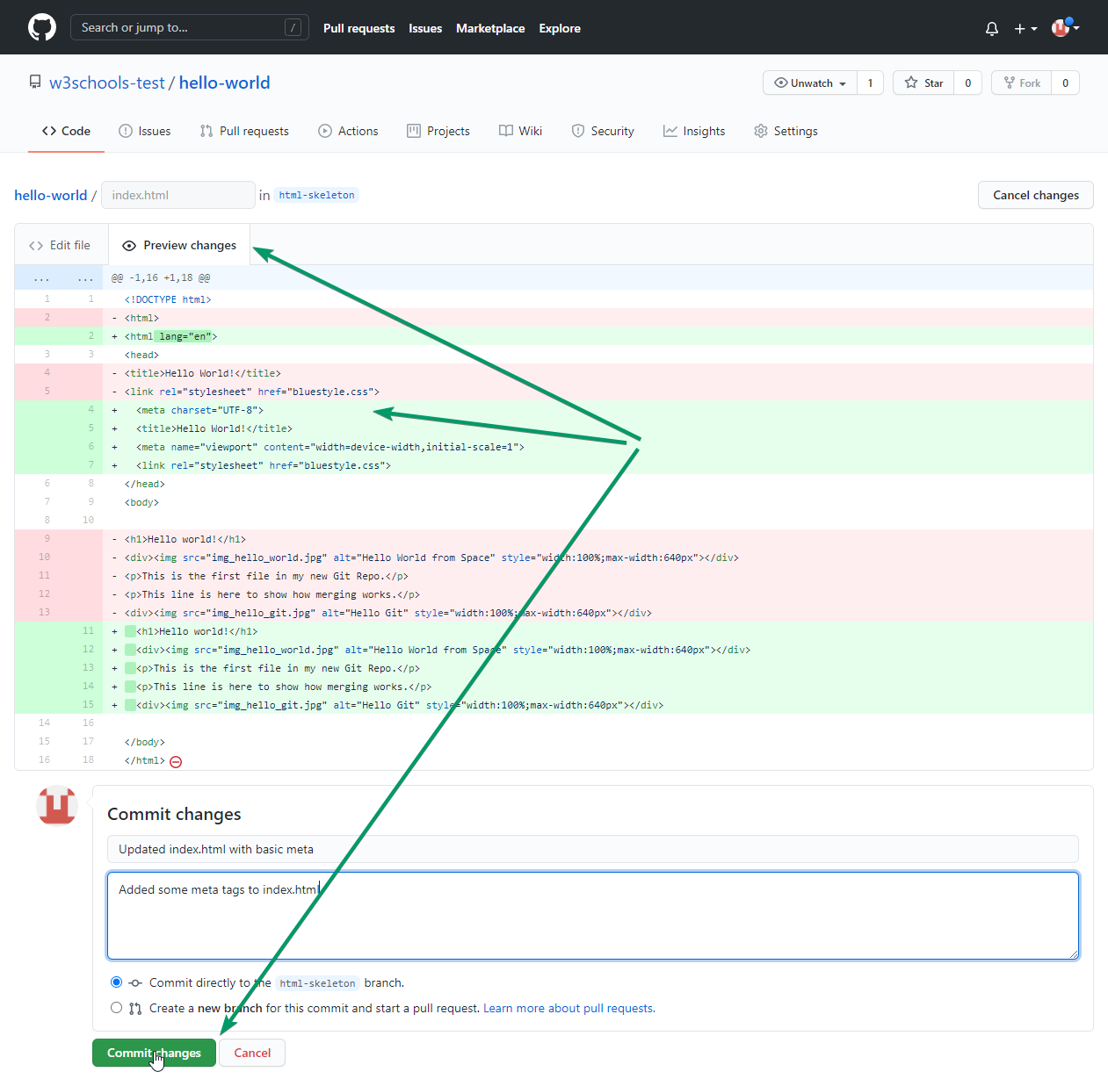
Git GitHub Branch
After you have finished editing the file, you can click the “Preview changes” tab to see the changes you made highlighted:

Slide 18
Git Branch Merge

Slide 19
Git Branch Merge
Merging in Git means combining the changes from one branch into another.
This is how you bring your work together after working separately on different features or bug fixes.
Common git merge Options
git merge - Merge a branch into your current branch
git merge --no-ff - Always create a merge commit
git merge --squash - Combine changes into a single commit
git merge --abort - Abort a merge in progress

Slide 20
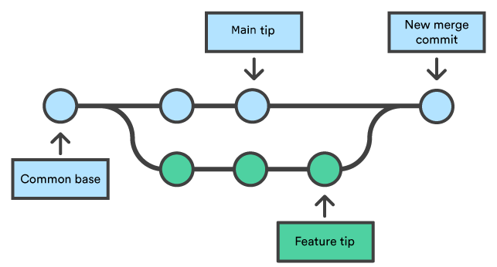
Merging Branches (git merge)
To combine the changes from one branch into another, use git merge.
Usually, you first switch to the branch you want to merge into (often main or master), then run the merge command with the branch name you want to combine in.
First, we need to change to the master branch:
git checkout master
Switched to branch “master”
Now we merge the current branch (master) with emergency-fix:
git merge emergency-fix
Updating 09f4acd..dfa79db
Fast-forward
index.html | 2 +-
1 file changed, 1 insertion(+), 1 deletion(-)

Slide 21
Merging Branches (git merge)
Best Practices for Merging Branches
Always commit or stash your changes before starting a merge.
Regularly merge from the main branch into your feature branch to minimize conflicts.
Read and resolve conflicts carefully—don't just accept all changes blindly.
Write clear and descriptive merge commit messages.
Practical Examples
Abort a merge: git merge --abort
Check status during a merge: git status
Resolve a conflict and complete the merge: Edit the conflicted file(s), then git add file and git commit
Fast-forward merge: Happens when no new commits diverged—Git just moves the branch pointer forward.
No-fast-forward merge: Use git merge --no-ff branch to always create a merge commit, preserving branch history.

Slide 22
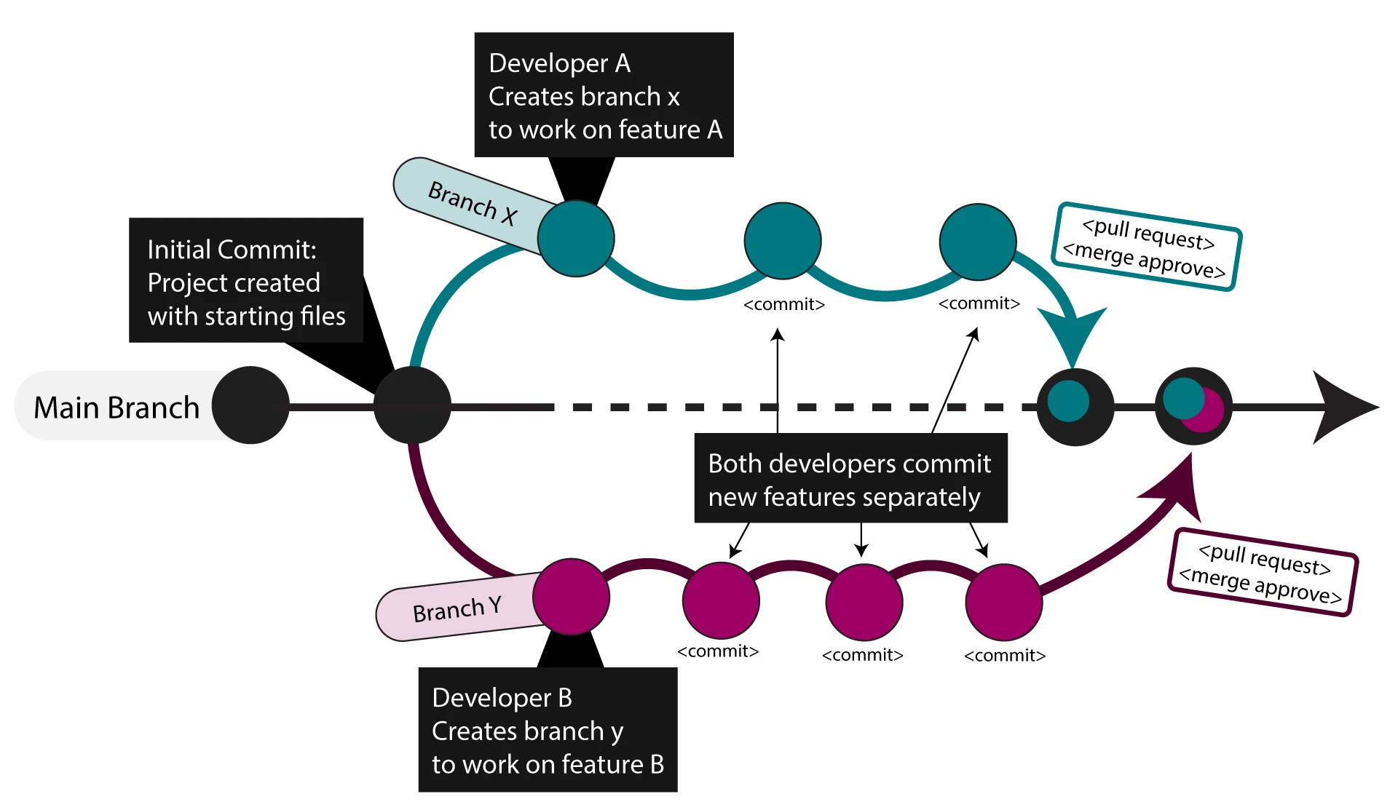
Merging Branches (git merge)

Slide 23
GitHub Fork

Slide 24
GitHub Fork
Forking means: Add to Someone Else’s Repository
This process is the heart of Git is collaboration.
However, Git does not allow you to add code to someone else’s repository without access rights.
Fork a Repository
A fork is a copy of a repository.
This is useful when you want to contribute to someone else's project or start your own project based on theirs.
fork is not a command in Git, but something offered in GitHub and other repository hosts.
Let's start by logging in to GitHub, and fork our repository: Mubshr07/ArtificialIntelligence-HITEC-Fall2025: A repo for subject material and Learning Git, GitHub, process Automation, Contribution and Collaboration.

Slide 25
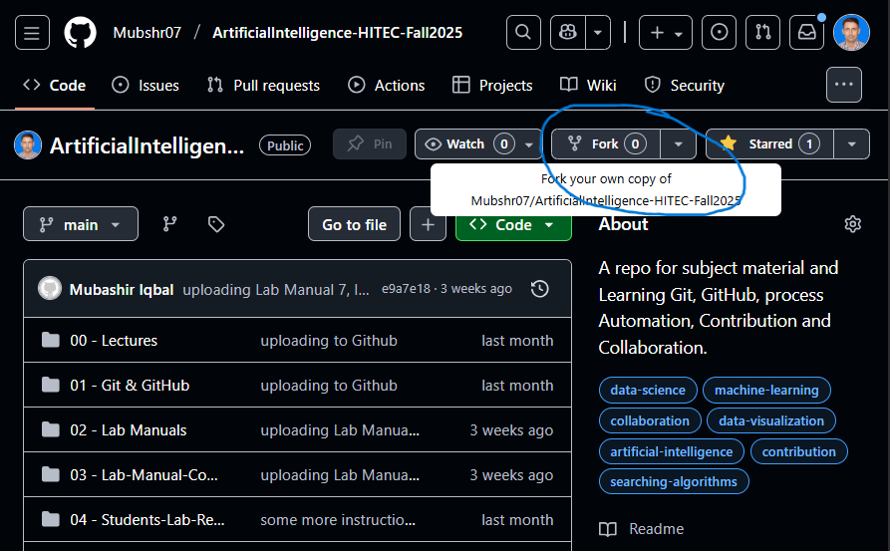
GitHub Fork

Slide 26
Why We Need Forking in GitHub
Forking allows you to create your own copy of someone else’s repository under your GitHub account.
1. You don’t have write access to the original repository
Open-source projects usually don’t let everyone push changes directly. Forking gives you your own space to work safely.
2. You can freely experiment
You can modify, break, or test anything in your fork without affecting the original repo.
3. It enables open-source contribution
After making improvements in your fork, you can request that the original project include your changes via a pull request.
4. Keeps contributions organized
Forks let maintainers review changes before merging, ensuring code quality and project stability.

Slide 27
How Forking Works
1. Find the repository you want to contribute to
On GitHub, open the repo page.
2. Click the “Fork” button
Located at the top-right. GitHub creates a copy of the repository under your username.
3. Clone your fork to your local machine
git clone https://github.com/your-username/repo-name.git
4. Create a new branch for your changes: (This is a best practice)
git checkout -b feature-branch
5. Make your changes locally
Edit code, add files, fix bugs, etc.
6. Commit and push your changes
git add .
git commit -m “Description of changes”
git push origin feature-branch

Slide 28
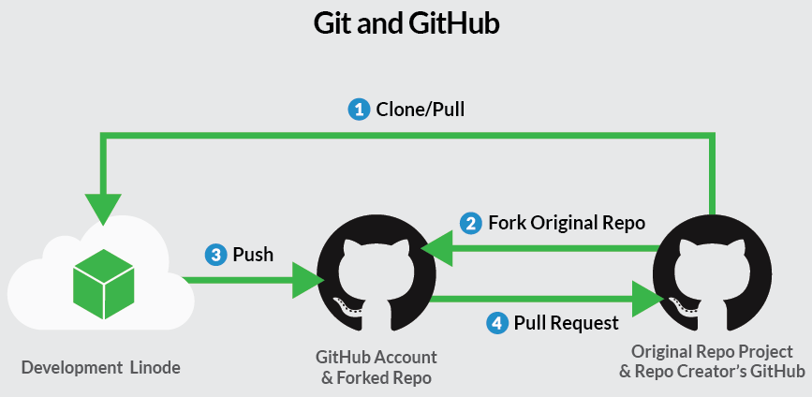
How to Create a Pull Request (PR)
1. Go to your fork on GitHub
You’ll see a message suggesting to “Compare & pull request” after pushing.
2. Click “Compare & pull request”
3. Write a PR title and description
Explain:
What you changed
Why the change is needed
Any issues it fixes (e.g., “Fixes #12”)
4. Select the correct base repository and branch
Usually:
base repo = original project
base branch = main or master
compare branch = your feature-branch
5. Submit the pull request
6. Wait for review
Maintainers may:
Approve and merge
Ask for changes
Discuss your contribution

Slide 29
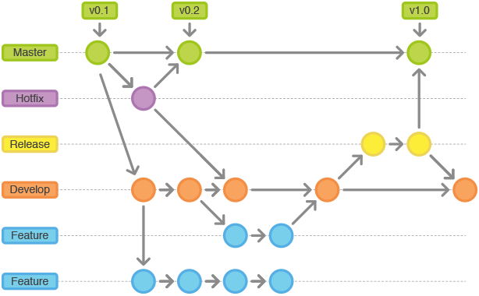
GitHub Fork

Slide 30
GitHub Trophies & Badges

Slide 31
GitHub Trophies (Community Feature)
These are not official GitHub features, but come from a popular open-source project called GitHub Profile Trophy.
What are GitHub Trophies?
They show categories like:
🥇 Commit Master
🏆 Issue Resolver
⭐ Star Giver
🧪 Test Developer
🍴 Fork Creator
👥 Follower Badge
These get generated based on your GitHub profile stats.

Slide 32







GitHub Badges
GitHub also includes official achievements on your profile: https://github.com/drknzz/GitHub-Achievements
S/No | Achievement | How to Earn It
1 | Pull Shark | Make many pull requests merged.
2 | Galaxy Brain | Have many discussions answered.
3 | YOLO | Merge a pull request without code review.
4 | Quickdraw | Close an issue or PR within 5 minutes.
5 | Starstruck | Get many stars on your repositories.
6 | Pair Extraordinaire | Co-author commits.
7 | Public Sponsor | Sponsor an open-source developer or project.

Slide 33
GitHub Badges
1. Pull Shark
You get this for making pull requests that get merged.
How to Get It
Open or fork a repository.
Make meaningful code changes.
Create a pull request (PR).
Get your PR merged by a maintainer.
Gold version: Many merged PRs.

Slide 34
GitHub Badges
2. Galaxy Brain
You provided accepted answers in GitHub Discussions.
How to Get It
Go to a repo with GitHub Discussions enabled.
Answer questions.
Your answer must be marked as “Accepted Answer”
Gold version = many accepted answers.

Slide 35
GitHub Badges
3. YOLO
You merged a pull request without any code review.
How to Get It
Create a PR on your repo.
Prerequisites
You need at least two branches (e.g., main and feature-branch).
The branch you want to merge must have commits that differ from the base branch.
Immediately click Merge Pull Request without requesting review.

Slide 36
GitHub Badges
4. Quickdraw
You closed an issue or PR extremely fast.
How to Get It
Create a repository with active issues/PRs.
Close an issue or PR within 5 minutes of it being created.
Very easy to get by creating and closing your own issue immediately.

Slide 37
GitHub Badges
5. Starstruck
Your repository gained many stars.
How to Get It
Create a public repository.
Share it widely (Reddit, X, GitHub community).
Earn 50+ stars for the standard badge.
Gold version requires much higher star count.

Slide 38
GitHub Badges
6. Pair Extraordinaire
You co-authored commits.
How to Get It
Work with someone on the same commit.
Add a co-author using this format in the commit message:
Co-authored-by: Name <email@example.com>
Push the commit.

Slide 39
GitHub Badges
7. Public Sponsor
You financially support open-source developers.
How to Get It
Go to any developer or project with GitHub Sponsors enabled.
Click Sponsor.
Choose a monthly amount ($1 works).
Badge appears instantly.

Slide 40

GitHub Badges
8. Heart On Your Sleeve
You reacted with ❤️ emojis a lot on GitHub.
How to Get It
Go to issues, PRs, or comments.
Add ❤️ reactions.
Do this many times across multiple repositories.

Slide 41

GitHub Badges
9. Open Sorcerer
You maintain a very popular open-source project.
How to Get It
Create a public repo.
Gain significant popularity (stars, community activity).
GitHub awards the badge automatically.
Hardest badge to earn naturally.

Slide 42
GitHub Badges
10. Mad Scientist
You experiment with many GitHub Actions workflows.
How to Get It
Add GitHub Actions workflows to multiple repositories.
Run workflow jobs many times.
Create or edit action files regularly.

Slide 43
GitHub Badges
11. Hyperpolyglot
You use many programming languages across repositories.
How to Get It
Create repos in different languages (Python, JS, Java, Go, etc.).
Push code in multiple languages.
GitHub counts languages automatically.

Slide 44
GitHub Badges
12. Pull Blaster
You created many PRs in a short time.
How to Get It
Make multiple small pull requests quickly.
They do not all need to be merged.
GitHub detects unusually high PR activity.

Slide 45
GitHub Badges
13. Release Radar
You created GitHub releases.
How to Get It
Go to a repository.
Open the Releases section.
Create a new release with a tag.
Publish it.

Slide 46
GitHub Organizations

Slide 47
GitHub Organizations
A GitHub Organization is a shared workspace for teams, companies, or open-source groups where multiple people collaborate on repositories.
Think of it as: A team account with controlled access and shared ownership.
Why Organizations are useful?
Manage permissions for members
Create team structures (devops, backend, contributors)
Group repositories under one identity
Use organization-wide settings, rules, and GitHub Actions
Professional collaboration (companies, startups, open-source teams)

Slide 48
GitHub Organizations
Example of famous GitHub Organizations:
Microsoft
Google
Facebook
Netflix
Kubernetes
OpenAI

Slide 49
How to Create a GitHub Organization
Go to: github.com/organizations/new
Choose:
Free plan or Team plan
Enter:
Organization name
Billing email
Add members
Create repositories under the organization

Slide 50


